Slide 1

Student Organization System (SOS)
Armando J. Ochoa –Minute Taker, System Architect
Yovanni Jones – Time Keeper, Tester
Anthony Sanchez-Ayra –Primary Facilitator, Database Administrator
Teriq Douglas – Accountant, Object Designer
M.Kian Maroofi – Team Leader, Front-End developer
Date: 12/03/2019
Notes:
Kian

Slide 2
Purpose and Scope of System
Provide a single point of access to all users to
Check all the organizations they belong to.
Find nearby events hosted by organizations.
Discover new organizations.
Connect with other members.
Manage organization leaders and their privileges.
Create and advertise organization-related events.
Out of Scope:
Social Media Features
Organization finance management.
Notes:
Armando

Slide 3
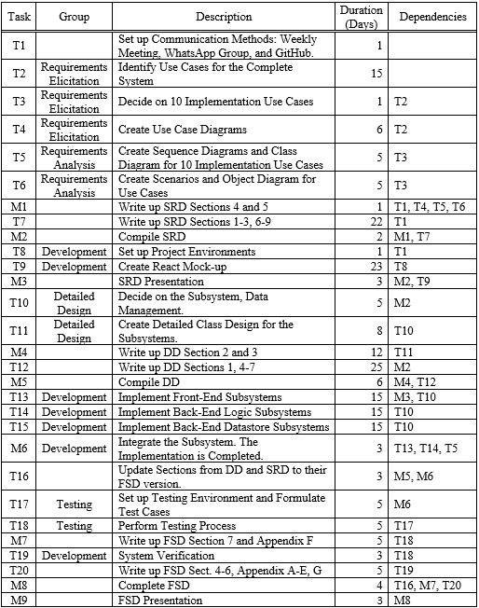
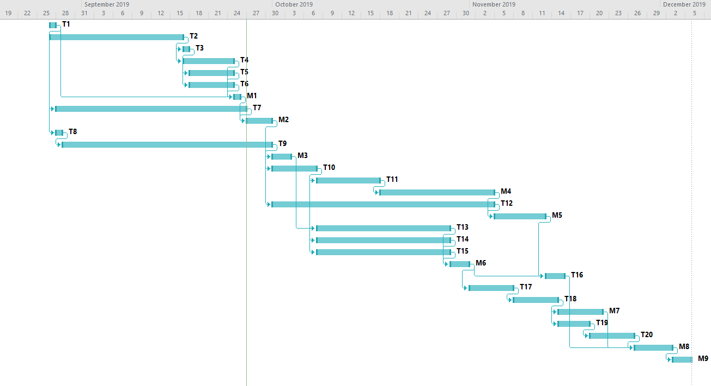
Project Schedule
Gant chart for the SOS Schedule.
Notes:
Armando

Slide 4
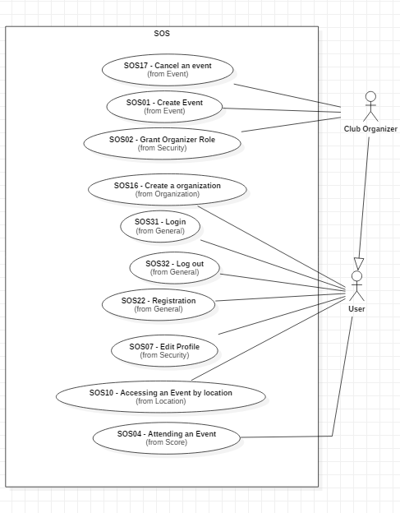
UML Use Case Diagram
Notes:
Yovanni

Slide 5
SOS16 Create Organization Functional Requirements
Preconditions - user is logged in.
Description:
User clicks on “Organization Tab.”
The webpage switches to Organization page.
User click on “Create Organization.”
User then fills out form asking for the Organization details.
User submits form to the Organization page.
Postconditions – user becomes Club Organizer for the Organization.
Notes:
Yovanni

Slide 6
SOS16 Create Organization Nonfunctional Requirements
Usability:
2 minutes to complete the request.
Reliability:
Mean time to failure – 5% monthly.
Performance:
200 requests per min and process each in 6 sec.
Criticality:
High. Main purpose of the system.
Frequency:
20 organization requests monthly.
Notes:
Yovanni

Slide 7
SOS07 Edit Profile Functional Requirements
Preconditions:
User is logged in.
Description:
User clicks “Edit Profile.”
User is shown an editable form.
User inputs the data and submits the request.
The webpage request the user’s password.
System authenticates their request.
Postconditions:
User data has been updated on the data storage.
Notes:
Kian

Slide 8
SOS07 Edit Profile Nonfunctional Requirements
Usability
20 sec to find and complete use case.
Reliability
Mean Time to Failure – 5% monthly.
Performance
20 checks per min and process each ~2 sec.
Criticality
Low. Secondary feature of the system.
Frequency:
20 profile edits per week.
Notes:
Kian

Slide 9
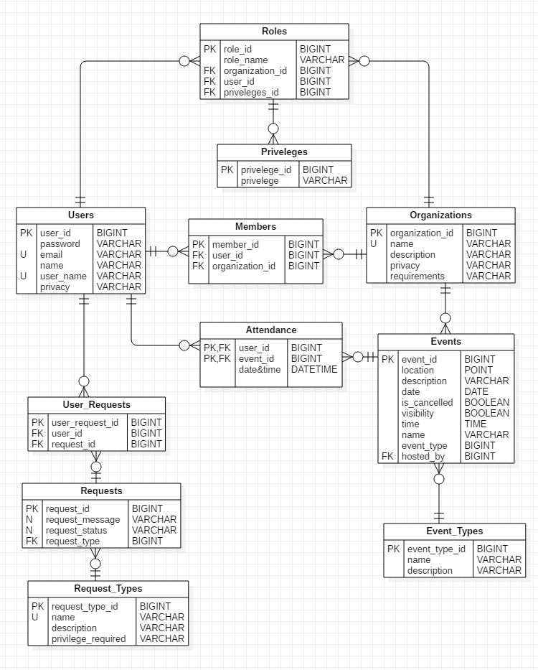
Data Management
The following tables are particularly relevant:
Users, which represent Actors for the Systems.
Organizations, which are groups of Users.
Events which are, hosted by Organizations and Attended by Users.

Slide 10
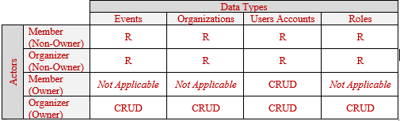
Security & Privacy: Data Management
Access Matrix for SOS.
Access Management is implemented by the front-end as part of the website are not presented if certain conditions aren’t met, i.e., Users can only see the “Edit Profile” button if they are logged in and on their own User Page.
Notes:
Armando

Slide 11
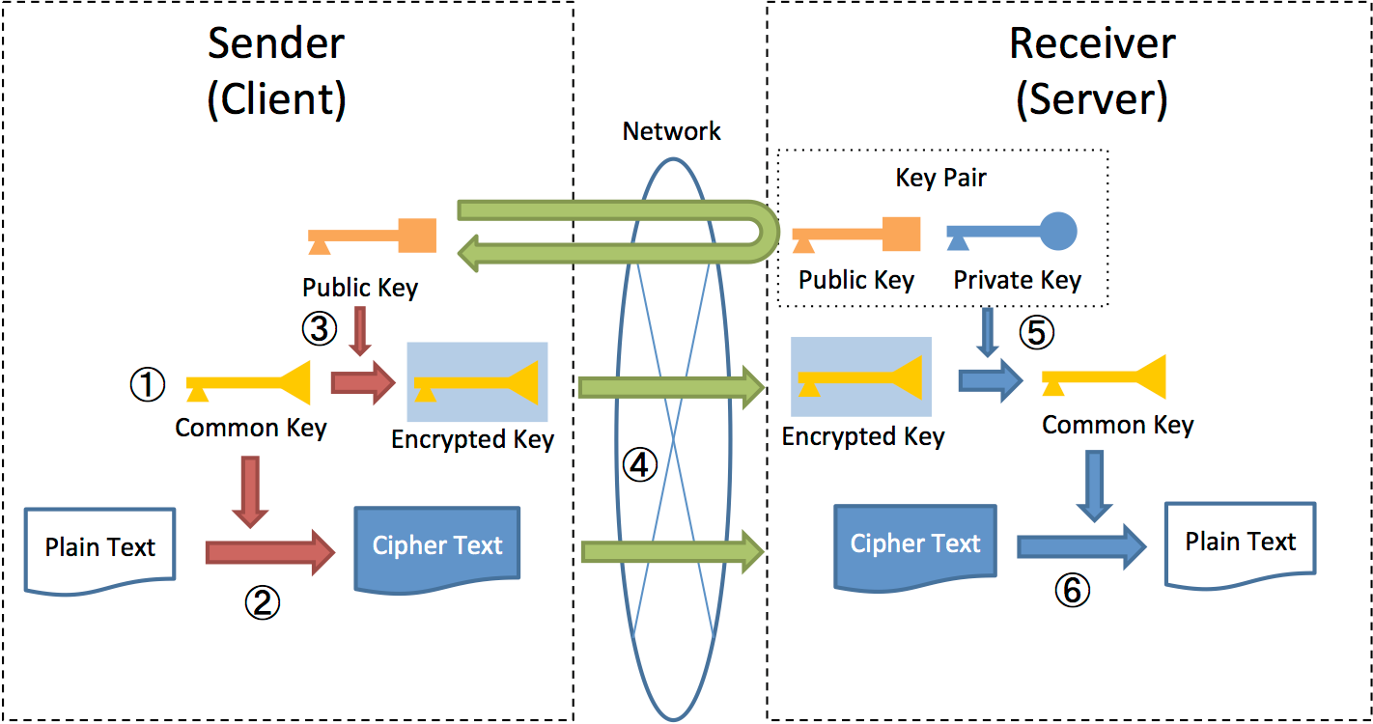
Security & Privacy: Encryption
Hybrid AES/RSA Schema for Data Exchange.
Transfer Management is implemented in both the backend and the frontend by means of hybrid encryption. Messages are sent as cyphers which only the intended receiver can decode.
Notes:
Armando

Slide 12
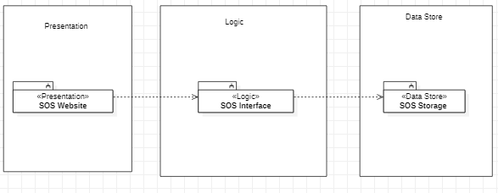
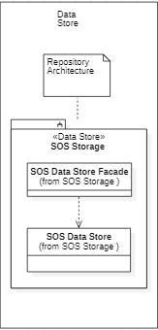
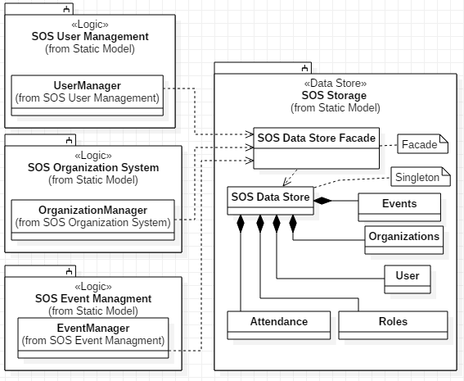
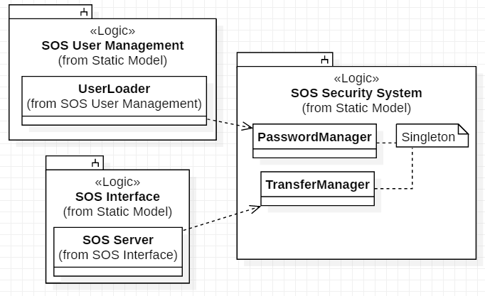
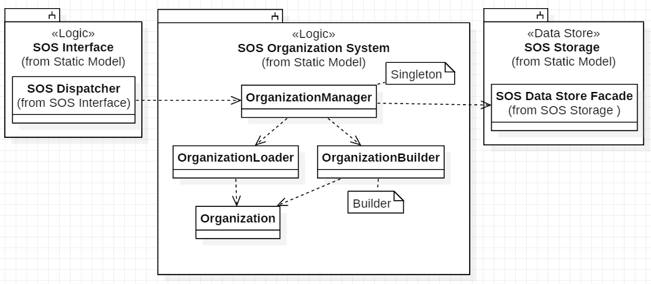
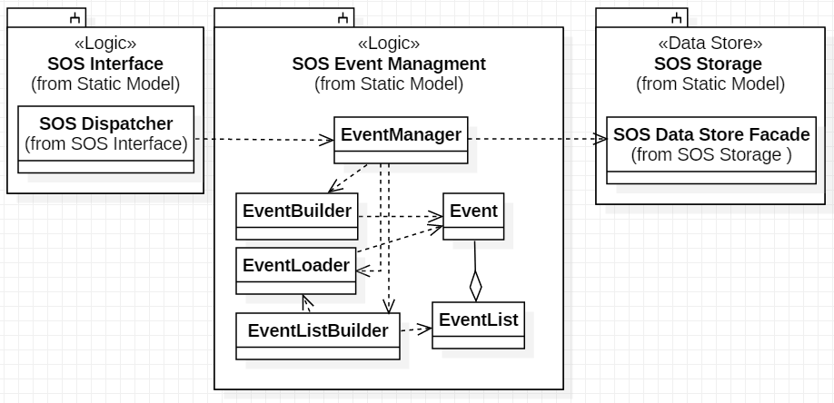
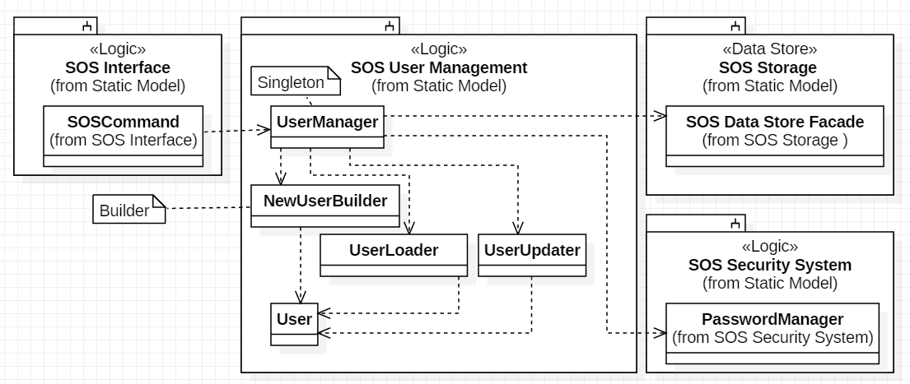
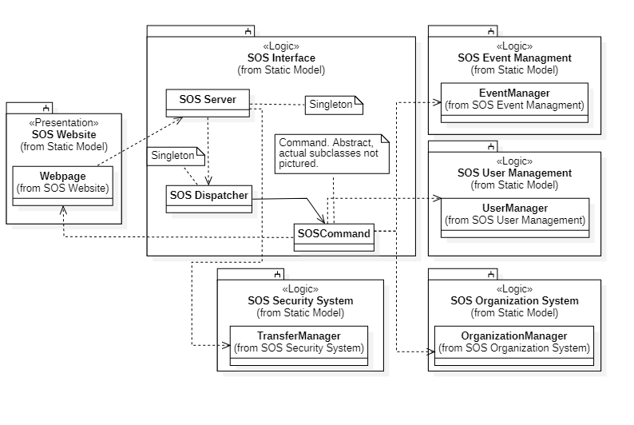
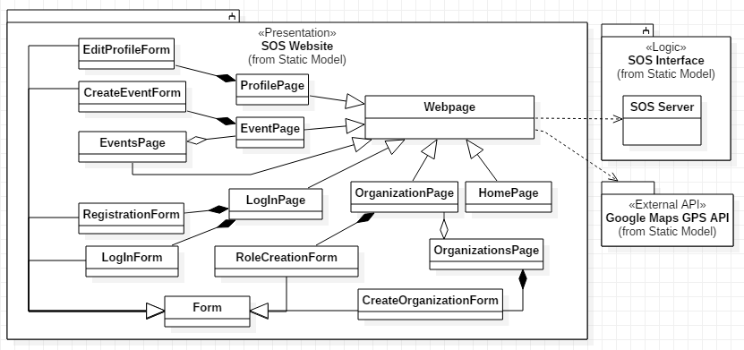
Minimal Class Diagram
Notes:
Needs to be updated
Anthony

Slide 13
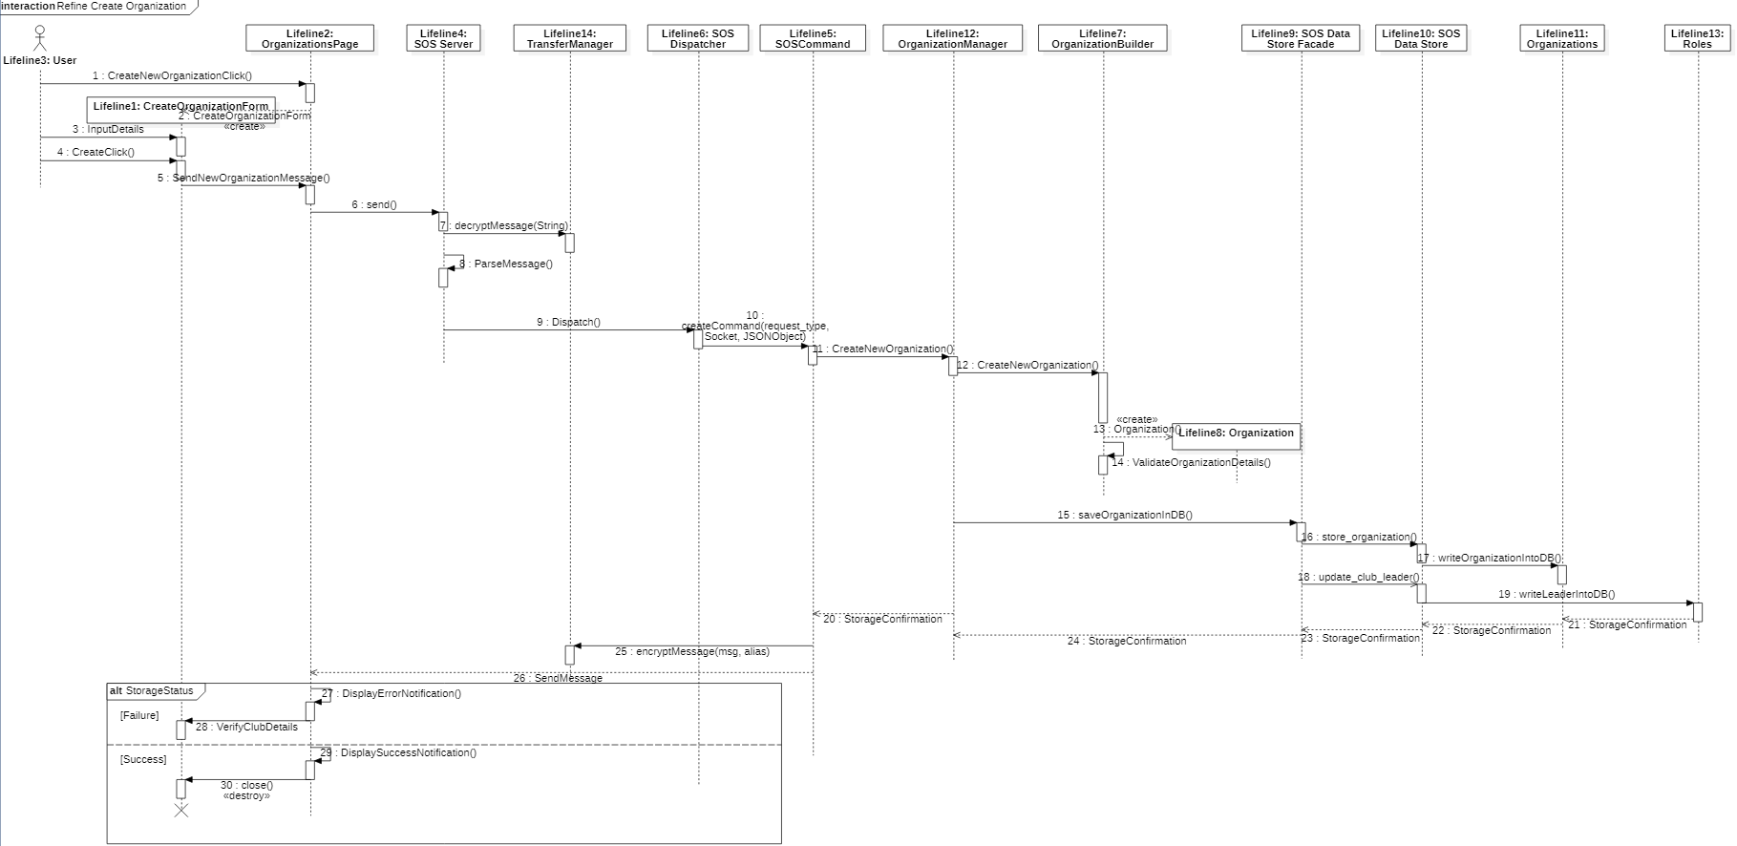
Sequence Diagram SOS16 Create Organization
Notes:
Anthony

Slide 14
Test Case: SOS07-System-017-Sunny-09
Purpose: Ensure that a User can change her email.
Test set-up: User exists in the System.
Input:
From profile page the user will click on ‘Edit Profile’.
A form pops-up with the current information.
The email field is changed to fab@gmail.com.
She will click the “submit” button and enters her password.
Expected Output: The SOS system display a success pop-up and displays the new email to the user.
Notes:
Kian

Slide 15
Test Case: SOS07-System-019-Rainy-09
Purpose: Test Cancel on the Edit Profile sequence.
Test set-up: User exists in the System.
Input:
1. Clicks on “Edit profile”.
2. A form pops-up with the current information.
3. User realizes she no longer wishes to change her information.
4. She presses the Cancel button to close the form.
Expected Output: No changes have occurred to profile information. User is back on profile page.
Notes:
Teriq

Slide 16
Test Case: SOS16-System-021-Sunny-12
Purpose: Ensure that a User can create an Organization.
Test set-up: User exists in the System and is logged in.
Input:
1. User clicks on “Create Organization”.
2. The corresponding input form is generated.
3. User enters data in respective fields: Organization Name = “QRT” ; Description = “Lets study” ; Requirements for Joining = none ; Privacy = “public”.
4. She then clicks on the “Submit”.
Expected Output: The request is submitted and the Organization will appear before the User.
Notes:
Teriq

Slide 17
Test Case: SOS16-System-023-Rainy-11
Purpose: Ensure that Org. Create has all relevant inputs.
Test set-up: User exists in the System and is logged in.
Input:
1. They click on the “Create Organization”.
2. The corresponding input form is generated.
3. She enters the following data: Organization Name = “My special club”.
4. Then she clicks on “Submit”.
Expected Output: A pop up message will appear in front of the user saying that some of the required fields have not been filled out.
Notes:
Teriq

